Slide 1


Xamarin + Microsoft Azure Hands On
99/4A
Ben Ishiyama-Levy
Xamarin Evangelist
ben@xamariners.com
http://www.meetup.com/SingaporeMobileDev/

Slide 2
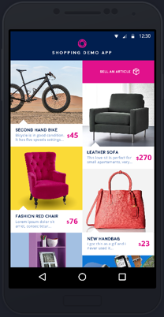
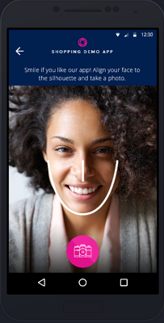
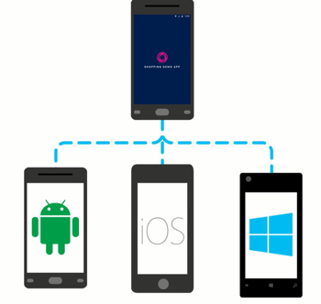
Shopping Demo App Overview
Learn how to connect your Xamarin mobile apps to the cloud.

Slide 3


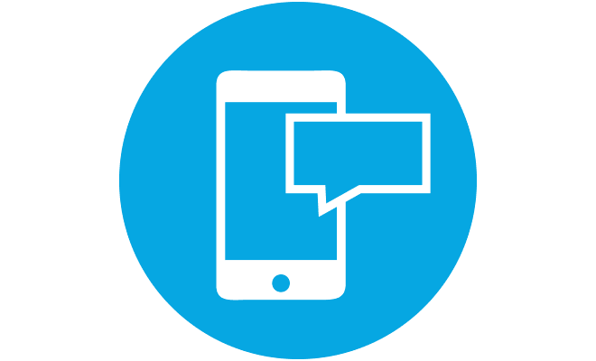

Shopping Demo App Overview
We are going to build a cross platform shopping app that uses a wide range of Azure services to help users:
authenticate with Facebook or Twitter
sell and buy personal items
get notifications when items are purchased
rate the app with a smile

Slide 4

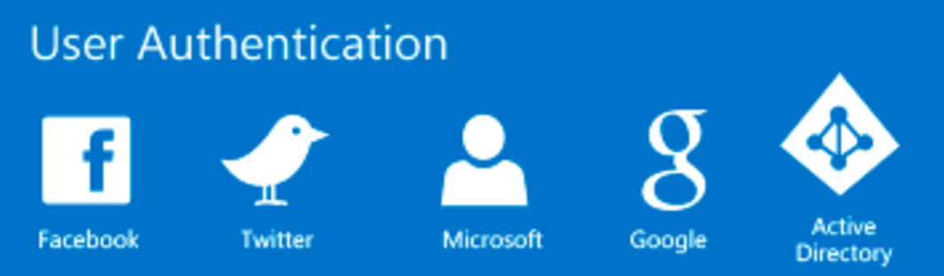
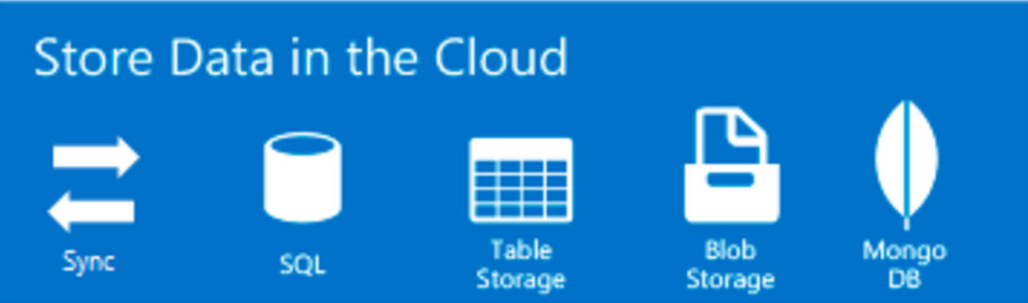
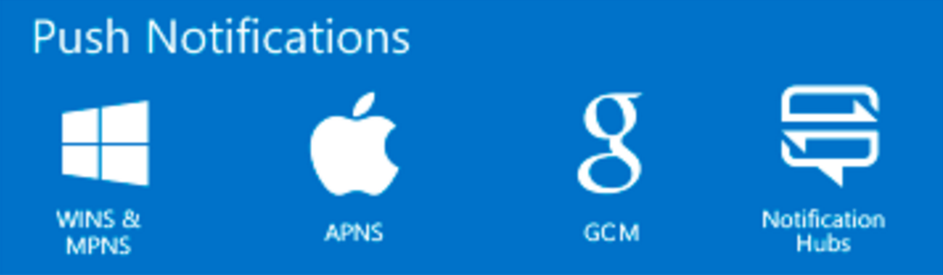
App Service
App Service is a platform-as-a-service (PaaS) offering of Microsoft Azure. It allows to create mobile apps for any platform or device.
You can integrate your apps with several SaaS solutions as Authentication, Push Notifications, Storage, etc.

Slide 5
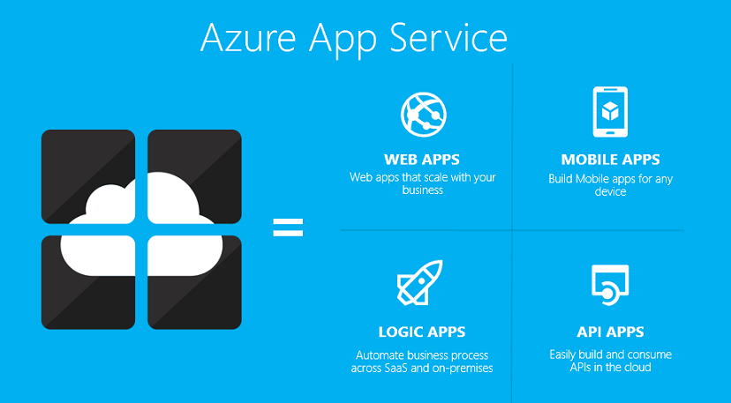
Notes:
Xamarin Forms is a new set of APIs allowing you to quickly and easily write shared User Interface code that is still rendered natively on each platform, while still providing direct access to the underlying SDKs if you need it.

Slide 6


Authenticate and authorize users
with Twitter and Facebook

Slide 7
Authenticate and authorize users with Twitter and Facebook
User Authentication enables single sign-on for your mobile app, so users can effortlessly authenticate with any cloud and on-premises app.
App Service supports five identity providers out of the box, including: Azure Active Directory, Facebook, Google, Microsoft Account, and Twitter, as well as your own custom identity solution.

Slide 8
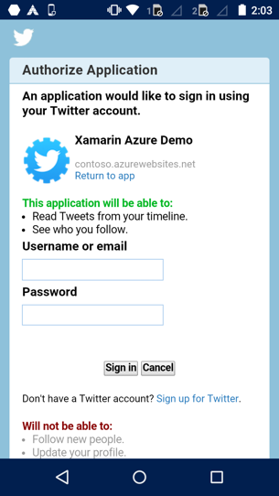
Authenticate and authorize users with Twitter and Facebook
Let’s add Twitter and Facebook authentication through Azure App Service with Mobile Apps in the Shopping Demo App.
https://github.com/Microsoft/XamarinAzure_ShoppingDemoApp/wiki/Authentication-Authorization

Slide 9
Sign up for Microsoft Azure
Open an Azure account for free: You get $200 azure credits that can be used to try out paid Azure services. Even after the credits are used up, you can keep the account and use free Azure services and features, such as the Web Apps feature in Azure App Service.
https://azure.microsoft.com/en-us/free
Activate Visual Studio subscriber benefits: Your Visual Studio subscription gives you $50 credits every month that you can use for paid Azure services.
https://my.visualstudio.com/benefits
Activate Visual Studio Dev Essentials benefits: Get $25 azure credits every month by joining Visual Studio Dev Essentials.
https://azure.microsoft.com/en-us/pricing/member-offers/vs-dev-essentials

Slide 10
Or set a temp App Service app
If you want to get started with Azure App Service before you sign up for an Azure account, go to Try App Service. There, you can immediately create a short-lived starter mobile app in App Service—no credit card required, and no commitments.
https://tryappservice.azure.com/

Slide 11

Set up the development environment
To start, set up your development environment by installing the latest version of:
Azure SDK
Xamarin
Visual Studio 2015
SQLite for Universal Windows Platform

Slide 12

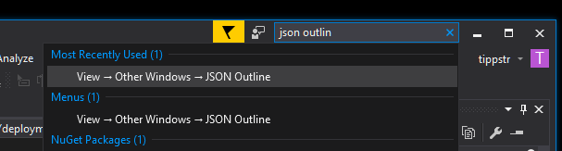
Setup backend web app
With Azure Deployment Templates
Online Azure Backend Setup:
https://deploy.azure.com/?repository=
https://github.com/Microsoft/XamarinAzure_ShoppingDemoApp#/form/setup
More about Azure Deployment templates:
https://azure.microsoft.com/en-us/documentation/articles
/vs-azure-tools-resource-groups-deployment-projects-create-deploy/
Note: The Visual Studio JSON Outline window is pretty useful for editing your
deployment templates

Slide 13
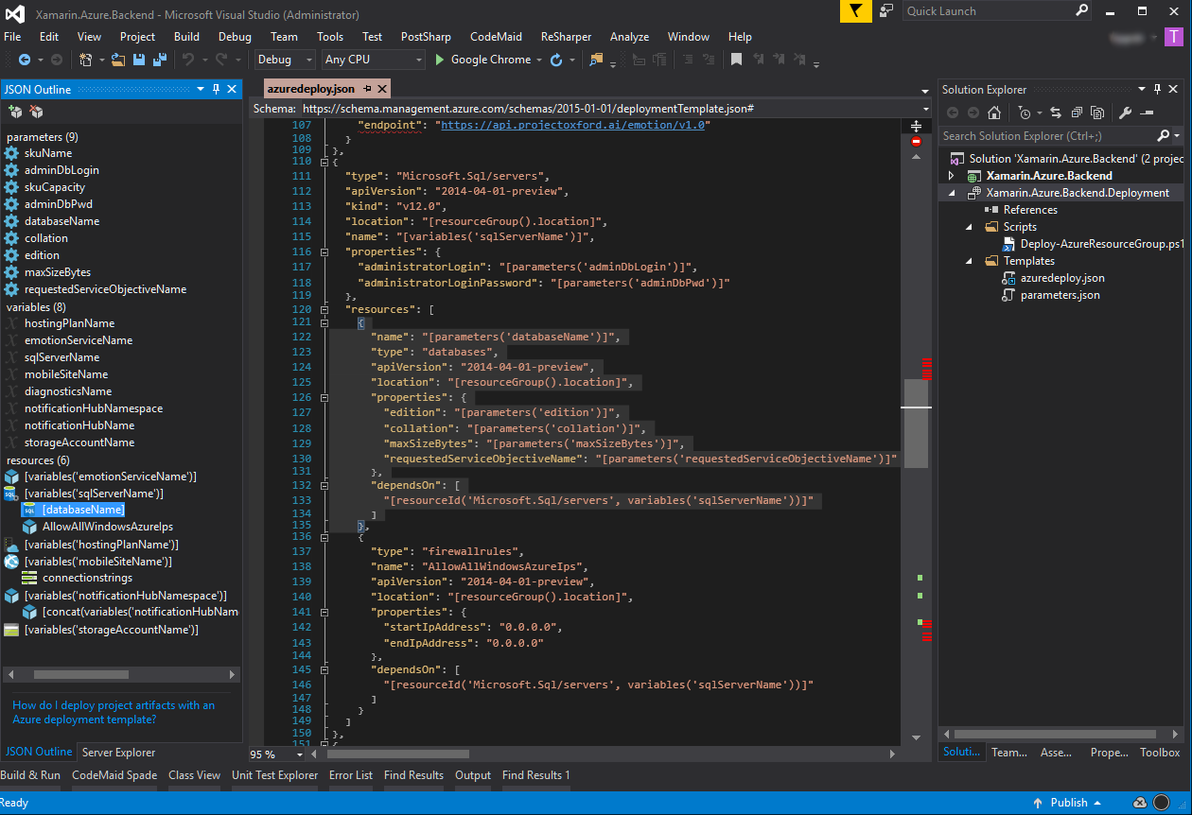
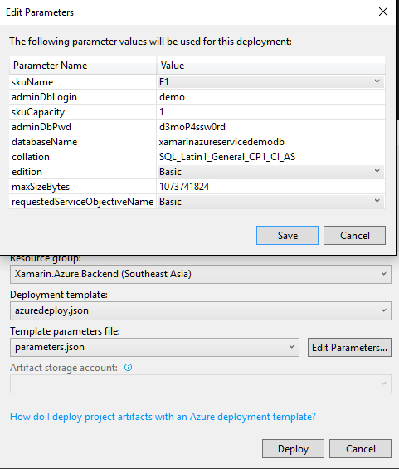
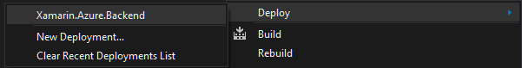
Deploy Xamarin.Azure.Backend
With Azure Deployment Templates
Deploy here

Slide 14
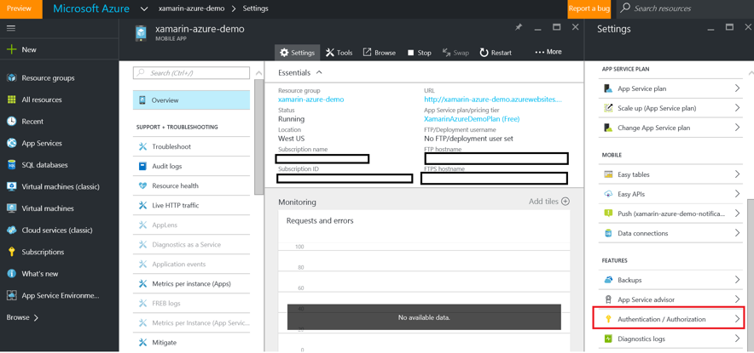
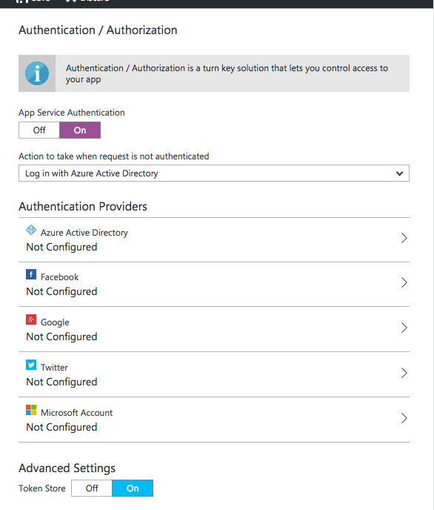
Setup Authentication in Azure Mobile Apps
Configuring Authentication in Azure is done within the Mobile App context.
Sign-up to Azure using the same subscription you used to deploy the Azure backend.
Within the Mobile App, you can find Authentication/Authorization in the Settings Pane
under Features.
Enable Authentication/Authorization by tapping on “On”.
Since we want to authenticate users just for selling new items,
we will allow requests when the user is not authenticated, i.e. taking no action,
and control manually that scenario.

Slide 15
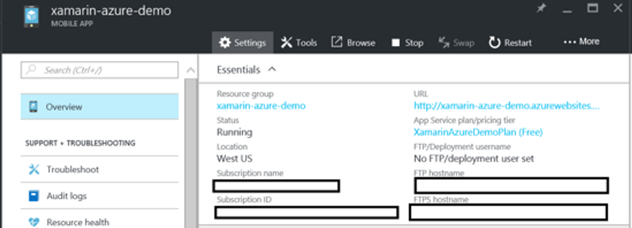
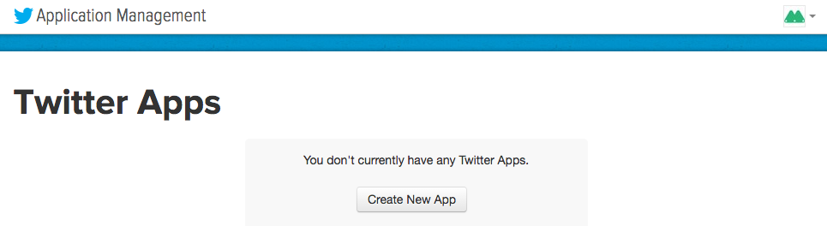
Configure twitter Authentication:
Register your application with Twitter
You must have a Twitter account that has a verified email address and phone number. To create a new Twitter account, go to twitter.com
Log on to the Azure portal https://portal.azure.com/ , and navigate to your application. Copy your URL. You will use this to configure your Twitter app
Navigate to the Twitter Developers website https://apps.twitter.com/ , sign in with your Twitter account credentials, and click Create New App.

Slide 16
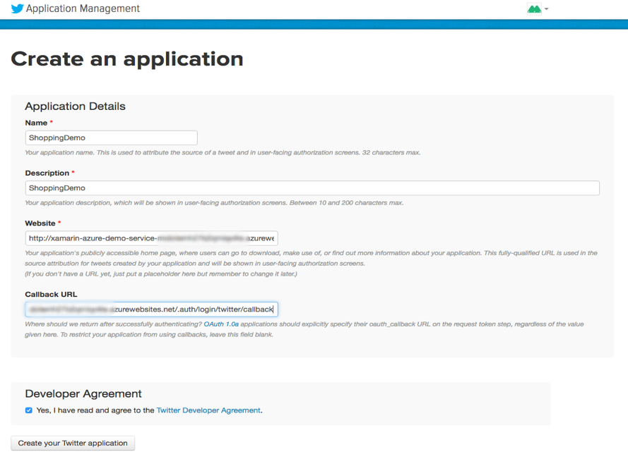
Configure twitter Authentication:
Register your application with Twitter
Type in the Name and a Description for your new app. Paste in your application's URL for the Website value.
For the Callback URL, paste the Callback URL you copied earlier. This is your Mobile App gateway appended with the path, /.auth/login/twitter/callback. For example https://contoso.azurewebsites.net/.auth/login/twitter/callback. Make sure that you are using the HTTPS scheme.
At the bottom the page, read and accept the terms. Then click Create your Twitter application. This registers the app displays the application details.

Slide 17
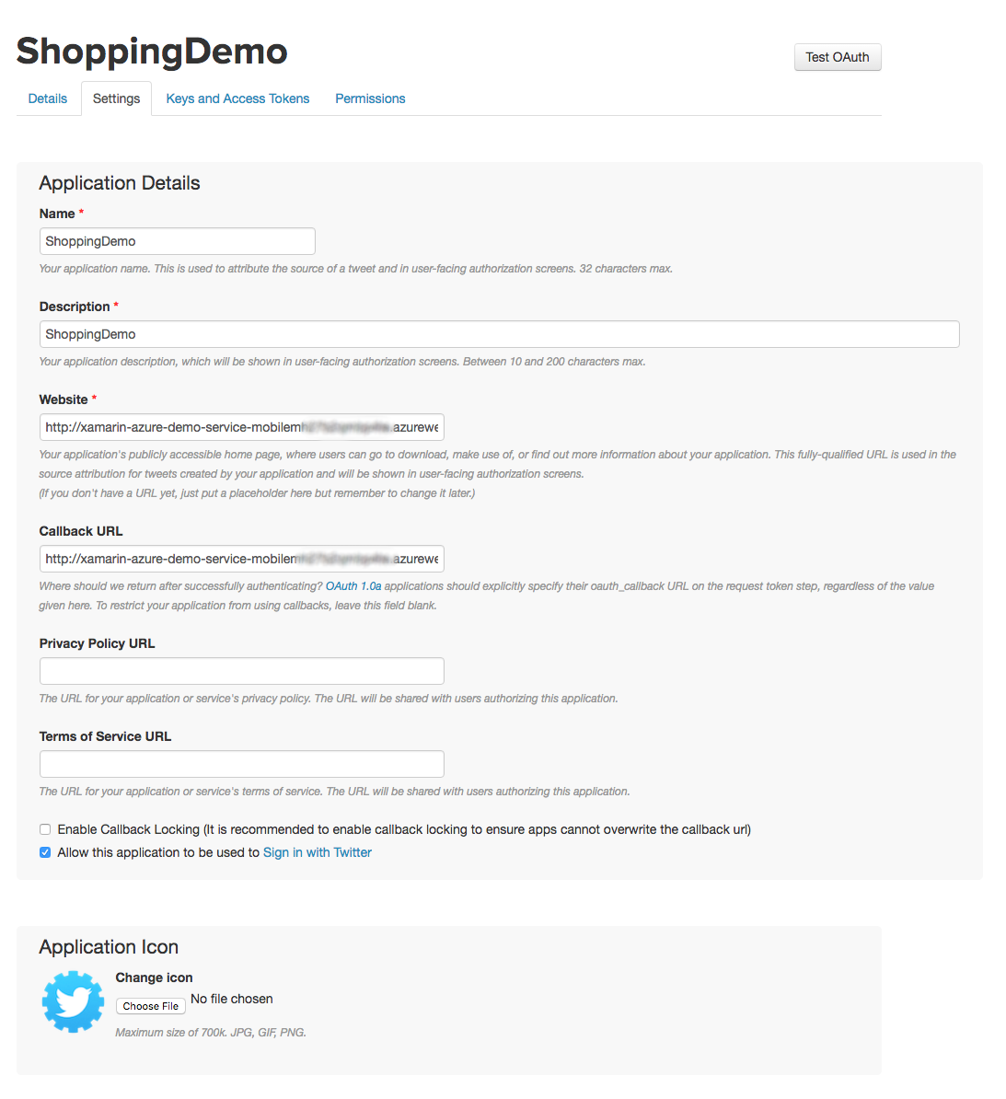
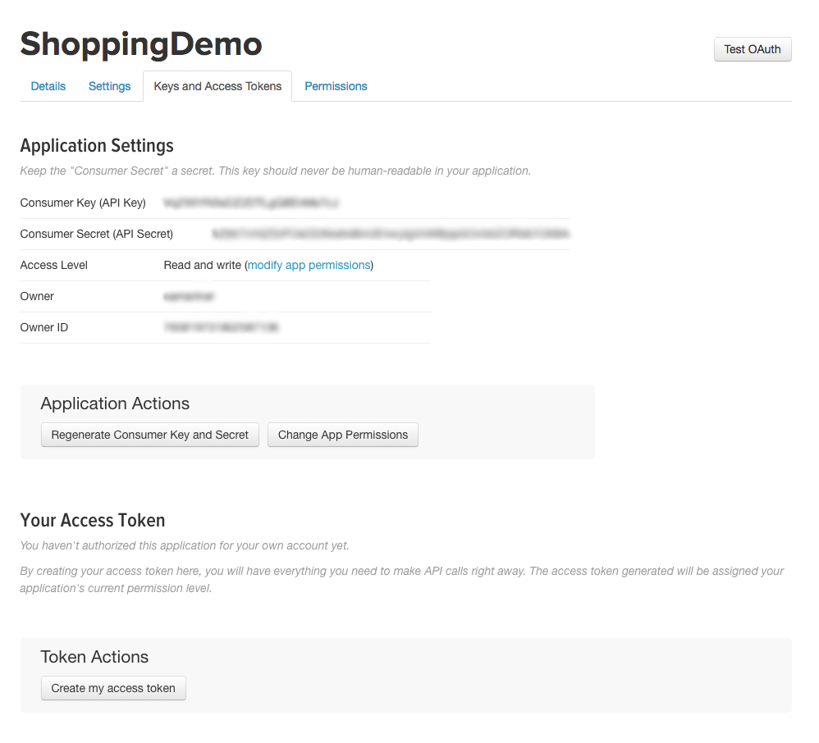
Configure twitter Authentication:
Register your application with Twitter
Click the Settings tab, check Allow this application to be used to sign in with Twitter, then click Update Settings.
Select the Keys and Access Tokens tab. Make a note of the values of Consumer Key (API Key) and Consumer secret (API Secret). The consumer secret is an important security credential. Do not share this secret with anyone or distribute it with your app.

Slide 18
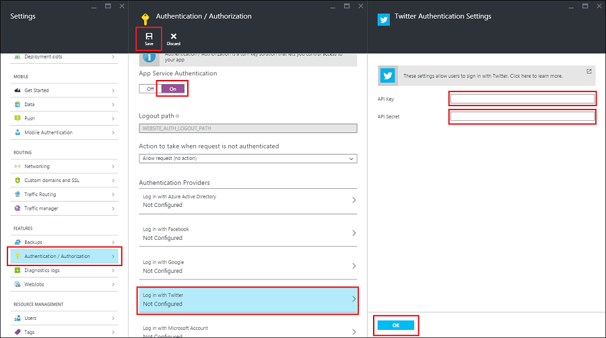
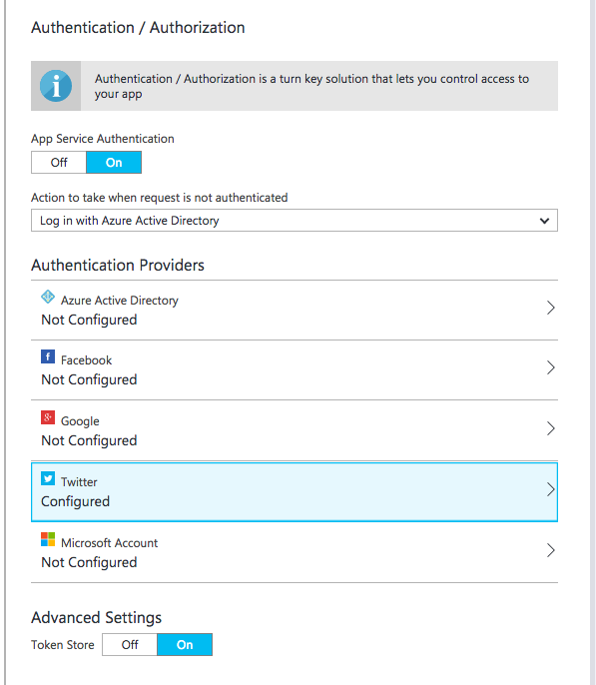
Configure twitter Authentication:
Add Twitter information to your application
Back in the Azure portal, navigate to your application. Click Settings, and then Authentication / Authorization.
If the Authentication / Authorization feature is not enabled, turn the switch to On.
Click Twitter. Paste in the App ID and App Secret values which you obtained previously. Then click OK.
By default, App Service provides authentication but does not restrict authorized access to your site content and APIs. You must authorize users in your app code.
(Optional) To restrict access to your site to only users authenticated by Twitter, set Action to take when request is not authenticated to Twitter. This requires that all requests be authenticated, and all unauthenticated requests are redirected to Twitter for authentication.
Click Save.

Slide 19
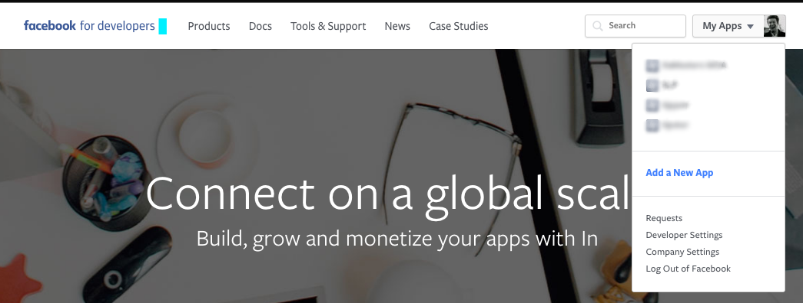
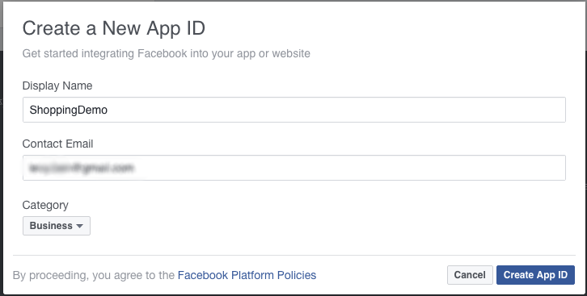
Configure facebook Authentication:
Register your application with Facebook
You must have a Facebook account that has a verified email address and phone number. To create a new Twitter account, go to facebook.com
Log on to the Azure portal https://portal.azure.com/ , and navigate to your application. Copy your URL. You will use this to configure your Facebook app
In Display Name, type a unique name for your app, type your Contact Email, choose a Category for your app, then click Create App ID and complete the security check. This takes you to the developer dashboard for your new Facebook app.
Navigate to the Facebook Developers website https://developers.facebook.com/ , sign in with your Facebook account credentials, and click My App/ Add New App.

Slide 20
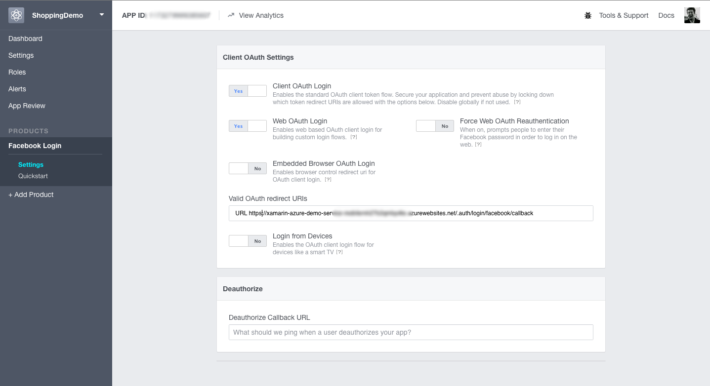
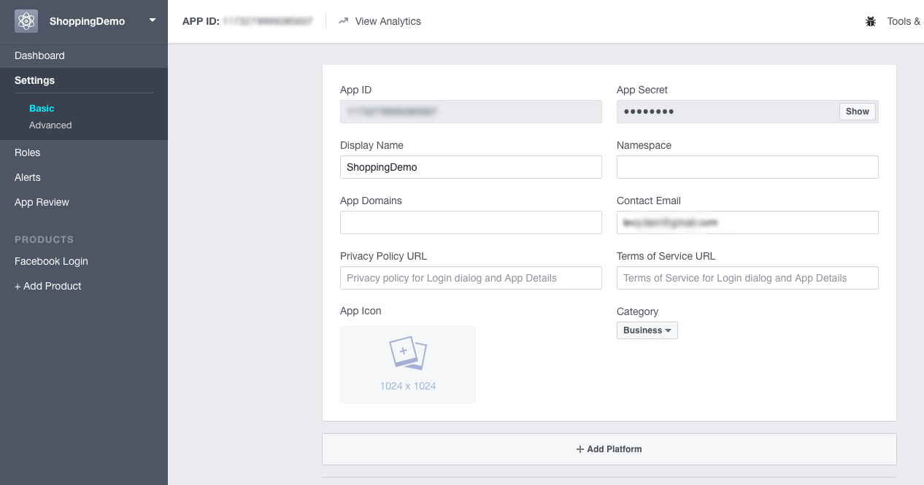
Configure facebook Authentication:
Register your application with Facebook
Under "Facebook Login," click Get Started / Settings. Add your application's Redirect URI to Valid OAuth redirect URIs, then click Save Changes. Your redirect URI is the URL of your application appended with the path, /.auth/login/facebook/callback. For example, https://contoso.azurewebsites.net/.auth/login/facebook/callback. Make sure that you are using the HTTPS scheme.
In the left-hand navigation, click Settings. On the App Secret field, click Show, provide your password if requested, then make a note of the values of App ID and App Secret. You use these later to configure your application in Azure.
The Facebook account which was used to register the application is an administrator of the app. At this point, only administrators can sign into this application. To authenticate other Facebook accounts, click App Review and enable Make public to enable general public access using Facebook authentication.

Slide 21
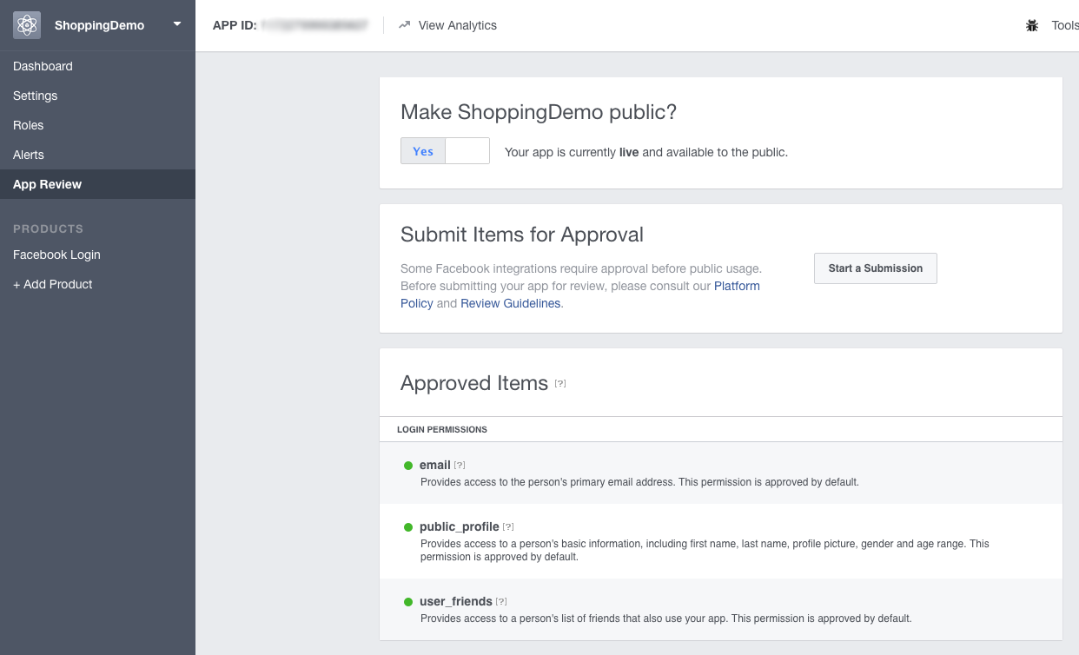
Configure facebook Authentication:
Register your application with Facebook
The Facebook account which was used to register the application is an administrator of the app. At this point, only administrators can sign into this application. To authenticate other Facebook accounts, click App Review and enable Make public to enable general public access using Facebook authentication.

Slide 22
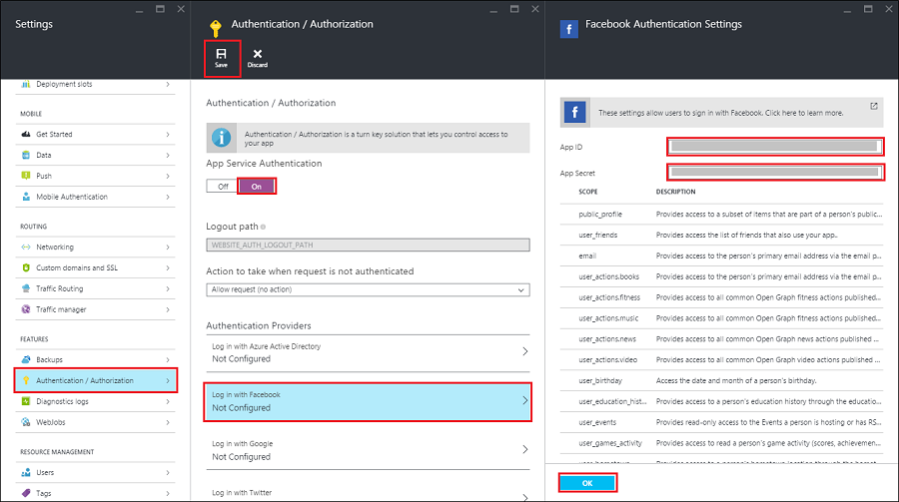
Configure facebook Authentication:
Add Facebook information to you application
Back in the Azure portal, navigate to your application. Click Settings > Authentication / Authorization, and make sure that App Service Authentication is On.
Click Facebook, paste in the App ID and App Secret values which you obtained previously, optionally enable any scopes needed by your application, then click OK.
By default, App Service provides authentication but does not restrict authorized access to your site content and APIs. You must authorize users in your app code.
(Optional) To restrict access to your site to only users authenticated by Facebook, set Action to take when request is not authenticated to Facebook. This requires that all requests be authenticated, and all unauthenticated requests are redirected to Facebook for authentication.
When done configuring authentication, click Save.

Slide 23
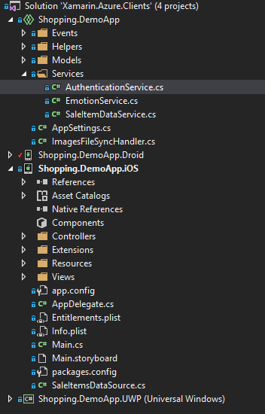
Set up Authentication in client side
The client authentication happens entirely in the Shared Project. AuthenticationService class provides a singleton instance which simplifies everything to a single call: RequestLoginIfNecessary(). Authentication starts when the app asks user user to select a preferred provider: Facebook or Twitter, and executes the Azure’s Authentication broker consequently based on user selection.
Depending on the target platform the call to LoginWithProviderAsync() differs, although differences are subtle and assure the consistence with OS’ SDK.

Slide 24

Set up Authentication in client side
Xamarin.iOS
private Task<MobileServiceUser> LoginWithProviderAsync(MobileServiceAuthenticationProvider provider)
{
var window = UIKit.UIApplication.SharedApplication.KeyWindow;
var vc = window.RootViewController;
// take top presented view controller
while (vc.PresentedViewController != null)
{
vc = vc.PresentedViewController;
}
return SaleItemDataService.Instance.MobileService.LoginAsync(vc, provider);
}

Slide 25

Set up Authentication in client side
Xamarin.Android
private Task<MobileServiceUser> LoginWithProviderAsync(MobileServiceAuthenticationProvider provider)
{
return SaleItemDataService.Instance.MobileService.LoginAsync
(Plugin.CurrentActivity.CrossCurrentActivity.Current.Activity, provider);
}

Slide 26

Set up Authentication in client side
Windows 10 Mobile
//// In UWP we need to be logged in to subscribe to push notifications
private async Task<MobileServiceUser> LoginWithProviderAsync(MobileServiceAuthenticationProvider provider)
{
var serviceUser = await SaleItemDataService.Instance.MobileService.LoginAsync(provider);
return serviceUser;
}

Slide 27
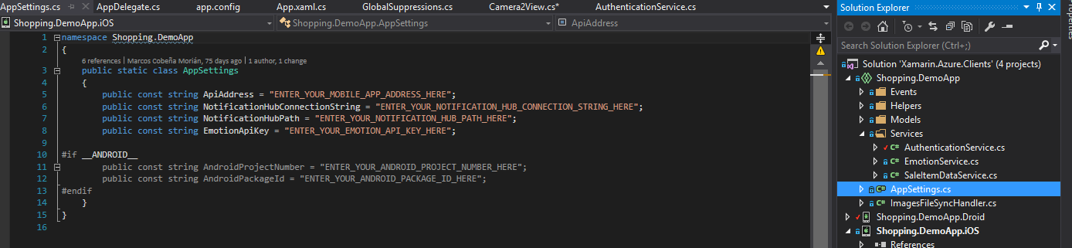
Set up Authentication in client side
Let’s run
Set the AppSettings ‘ApiAddress’ string with your mobile app address (https):
Run the App

Slide 28
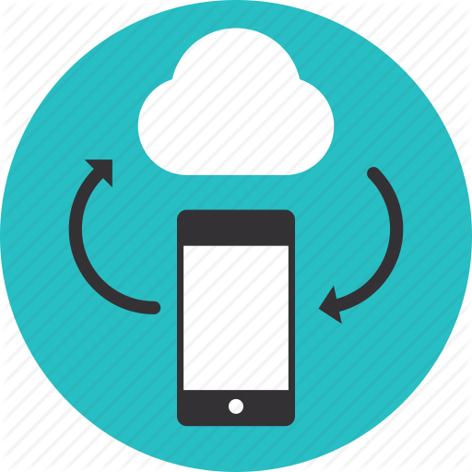
Offline Data Sync
Allow your app to work offline and sync after with Offline Data Sync

Slide 29



Offline Data Sync:
Allow your app to work offline and sync after with Offline Data Sync
Mobile users need to access data at all times, on and offline. Use offline data sync to make sure your users can view, create, and modify data, even when they experience connectivity issues or are offline.
The Azure Mobile SDK includes offline data sync capabilities, creating apps that remain functional without a network connection. When apps are in offline mode, users can access, create, and modify data of any type. Changes are stored locally, and, when the app detects a network connection, checks for conflicts with Azure Mobile App backend, and synchronizes locally stored data accordingly.
When your app is in offline mode, users can still create and modify data, which will be saved to a local store. When the app is back online, it can synchronize local changes with your Azure Mobile App backend.

Slide 30


Offline Data Sync:
Allow your app to work offline and sync after with Offline Data Sync
The feature also includes support for detecting conflicts when the same record is changed on both the client and the backend. Conflicts can then be handled either on the server or the client.
Apps render information from a remote server. When users experience connectivity issues or are offline, a common development practice is to keep a local version of the information. However, this approach is not optimal.
Azure’s Offline Data Sync helps developers solve offline scenarios with few lines of code. Offline Data Sync allows to push and pull data on demand. If eventually the Internet connection breaks up, the client automatically pulls data recovers from local storage.

Slide 31
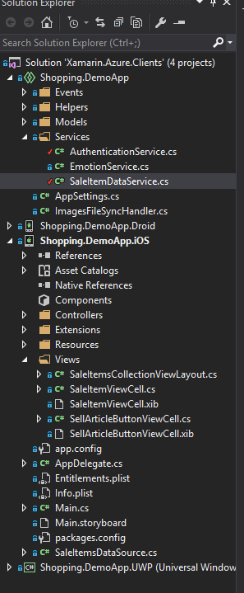
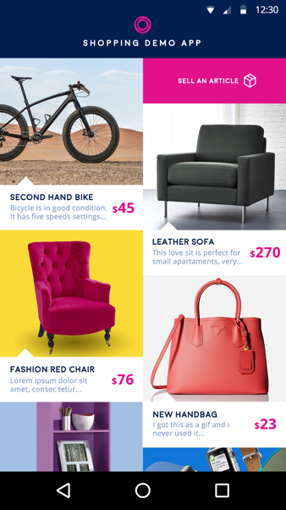
Offline Data Sync:
Enabling Offline Data Sync in client side
The following tutorial is focused the Shopping Demo App’s home page, where users can see a collection of items to be sold.
The Shopping Demo App consumes the Web App “Xamarin.Azure.Backend” we deployed in Azure.
The Xamarin.Azure.Backend project provides a shared API that enables offline sync within Xamarin.Android, Xamarin.iOS and Windows 10 Mobile project. On this project, you also need to use the NuGet package Microsoft.Azure.Mobile.Client.SQLiteStore for every platform.
The collection view which shows items in the home page consumes the SaleItemDataService class, wrapping the initialization and retrieval of elements.
Every platform must call SaleItemDataService.Initialize() before pulling items:

Slide 32

Offline Data Sync:
Enabling Offline Data Sync in client side
This method initializes the SQLite local storage (just for the very first time), instantiates the client which will let us consume the Web API, and gives the app a “sync. table” for the sale items. This table is a mirror of the data available in Azure, letting us work with it locally and, finally, pushing everything to the cloud.
public async Task Initialize()
{
const string path = "syncstore.db";
//Create our client
this.MobileService = new MobileServiceClient(AppSettings.ApiAddress);
//We add MobileServiceFileJsonConverter to the list of available converters to avoid an internal that occurs randomly
this.MobileService.SerializerSettings.Converters.Add(new MobileServiceFileJsonConverter(this.MobileService));
//setup our local sqlite store and intialize our table
var store = new MobileServiceSQLiteStore(path);
store.DefineTable<SaleItem>();
//Get our sync table that will call out to azure
this.saleItemsTable = this.MobileService.GetSyncTable<SaleItem>();
}

Slide 33
Offline Data Sync:
Enabling Offline Data Sync in client side
From client platforms we will consequently call SaleItemDataService.GetSaleItems(), which assures saleItemsTable is synced prior to projecting the list back to the views.
The important bits regarding data syncing happen in the following lines of code:
await this.MobileService.SyncContext.PushAsync();
await this.saleItemsTable.PullAsync("allSaleItems", this.saleItemsTable.CreateQuery());
Two things happen here which are noticeable:
Every modification is pushed to Azure in advance.
The latest version of the data from Azure, regarding sale items, is downloaded to the client.
That way we assure data to represent is coherent with data stored in Azure, including data changes performed by the user locally.

Slide 34
Set up Offline Data Sync in client side
Xamarin.iOS
MainViewController.LoadSaleItems() is in charge of retrieving data and assigning it to the items source:
private async Task LoadSaleItems()
{
UserDialogs.Instance.ShowLoading("Loading..."); IEnumerable<SaleItem> data = await SaleItemDataService.Instance.GetSaleItems(); saleItemsSource.Items = data; SaleItemsCollectionView.ReloadData(); UserDialogs.Instance.HideLoading();
}

Slide 35
Set up Offline Data Sync in client side
Xamarin.Android
MainActivity.PopulateWithData() does the initialization and retrieval of items:
private async Task PopulateWithData()
{
await SaleItemDataService.Instance.Initialize();
var items = await SaleItemDataService.Instance.GetSaleItems();
this.saleItems.Clear();
this.saleItems.AddRange(items);
var dummyItemPosition = this.saleItems.Count == 0 ? 0 : 1;
this.saleItems.Insert(dummyItemPosition, default(SaleItem));
this.saleRecyclerAdapter.NotifyDataSetChanged();
}
Initialization happens during ViewDidLoad().

Slide 36
Set up Offline Data Sync in client side
Windows 10 Mobile
protected async override void OnNavigatedTo(NavigationEventArgs e)
{
base.OnNavigatedTo(e);
if (this.saleItemList.ItemsSource == null)
{
await SaleItemDataService.Instance.Initialize();
await this.InitNotificationsAsync();
await this.UpdateList();
. . .
private async Task UpdateList()
{
VisualStateManager.GoToState(this, LoadingState.Name, true);
var items = await SaleItemDataService.Instance.GetSaleItems();
this.saleItemList.ItemsSource = items;
VisualStateManager.GoToState(this, LoadedState.Name, true);
}

Slide 37
Set up Offline Data Sync in client side
Set the AppSettings ‘ApiAddress’ string with your mobile app address (https):
Run the App

Slide 38

Store your app data in the cloud with Azure Storage

Slide 39
Store your app data in the cloud with Azure Storage
Azure Storage is massively scalable, and accessible from anywhere and from any device – whether your users are online or off. Whether its images, photos, documents, or customer records – in the cloud or on premises – Azure makes it simple to create or integrate the right kind of storage for the task.
Azure Storage offers a set of storage services for all your business needs:
Blob storage (object storage) for unstructured data
File storage for SMB-based cloud file shares
Table storage for NoSQL data
Queue storage to reliably store messages
Premium Storage for high-performance, low-latency block storage for I/O-intensive workloads running in Azure Virtual Machines.

Slide 40
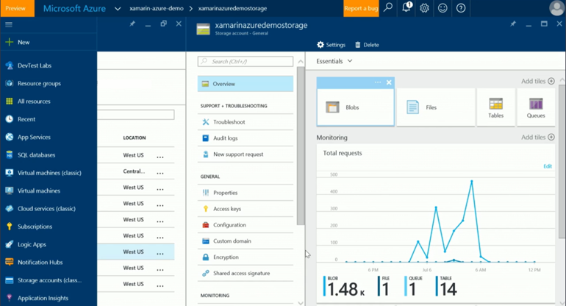
Store your app data in the cloud with Azure Storage
The Shopping Demo App relies in SQL Server for storing items (title, description, price, etc.), and uses Blob storage to store item photos.
Blob storage is then connected to Azure’s Mobile App, which enables the offline file sync scenario: items can be added offline and are automatically synced when the connection is back.

Slide 41
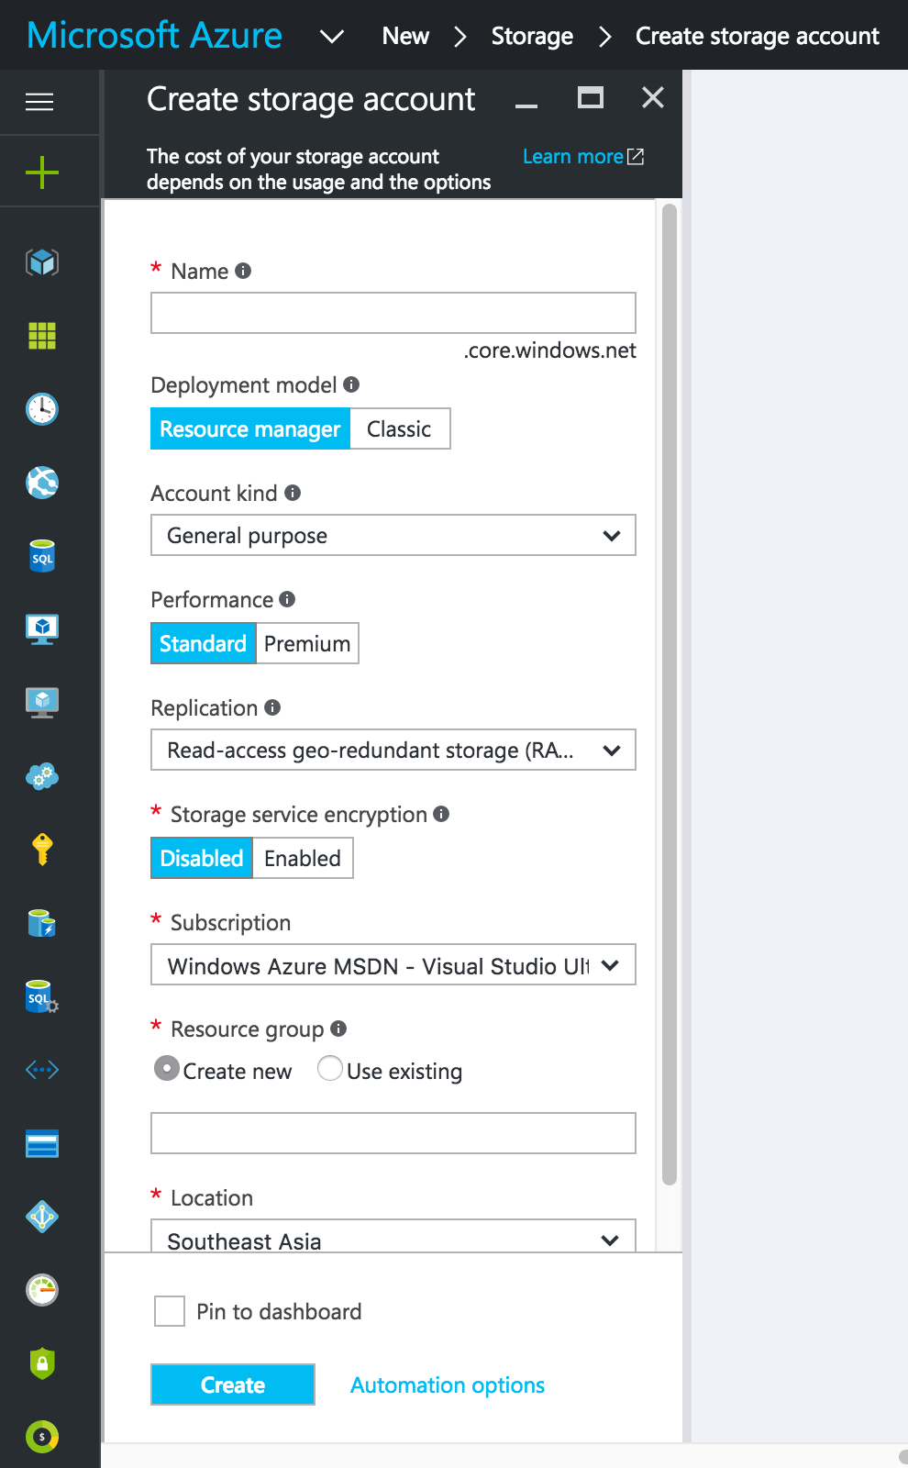
Store your app data in the cloud with Azure Storage
Create a storage account
Sign in to the Azure portal.
On the Hub menu, select New -> Data + Storage -> Storage account.
Enter a name for your storage account. See Storage account endpoints for details about how the storage account name will be used to address your objects in Azure Storage.
Specify the deployment model to be used: Resource Manager or Classic. Resource Manager is the recommended deployment model. For more information, see Understanding Resource Manager deployment and classic deployment.
Select the type of storage account: General purpose or Blob storage. General purpose is the default.
Select the subscription in which you want to create the new storage account.
Specify a new resource group or select an existing resource group
Select the geographic location for your storage account.
Click Create to create the storage account.

Slide 42
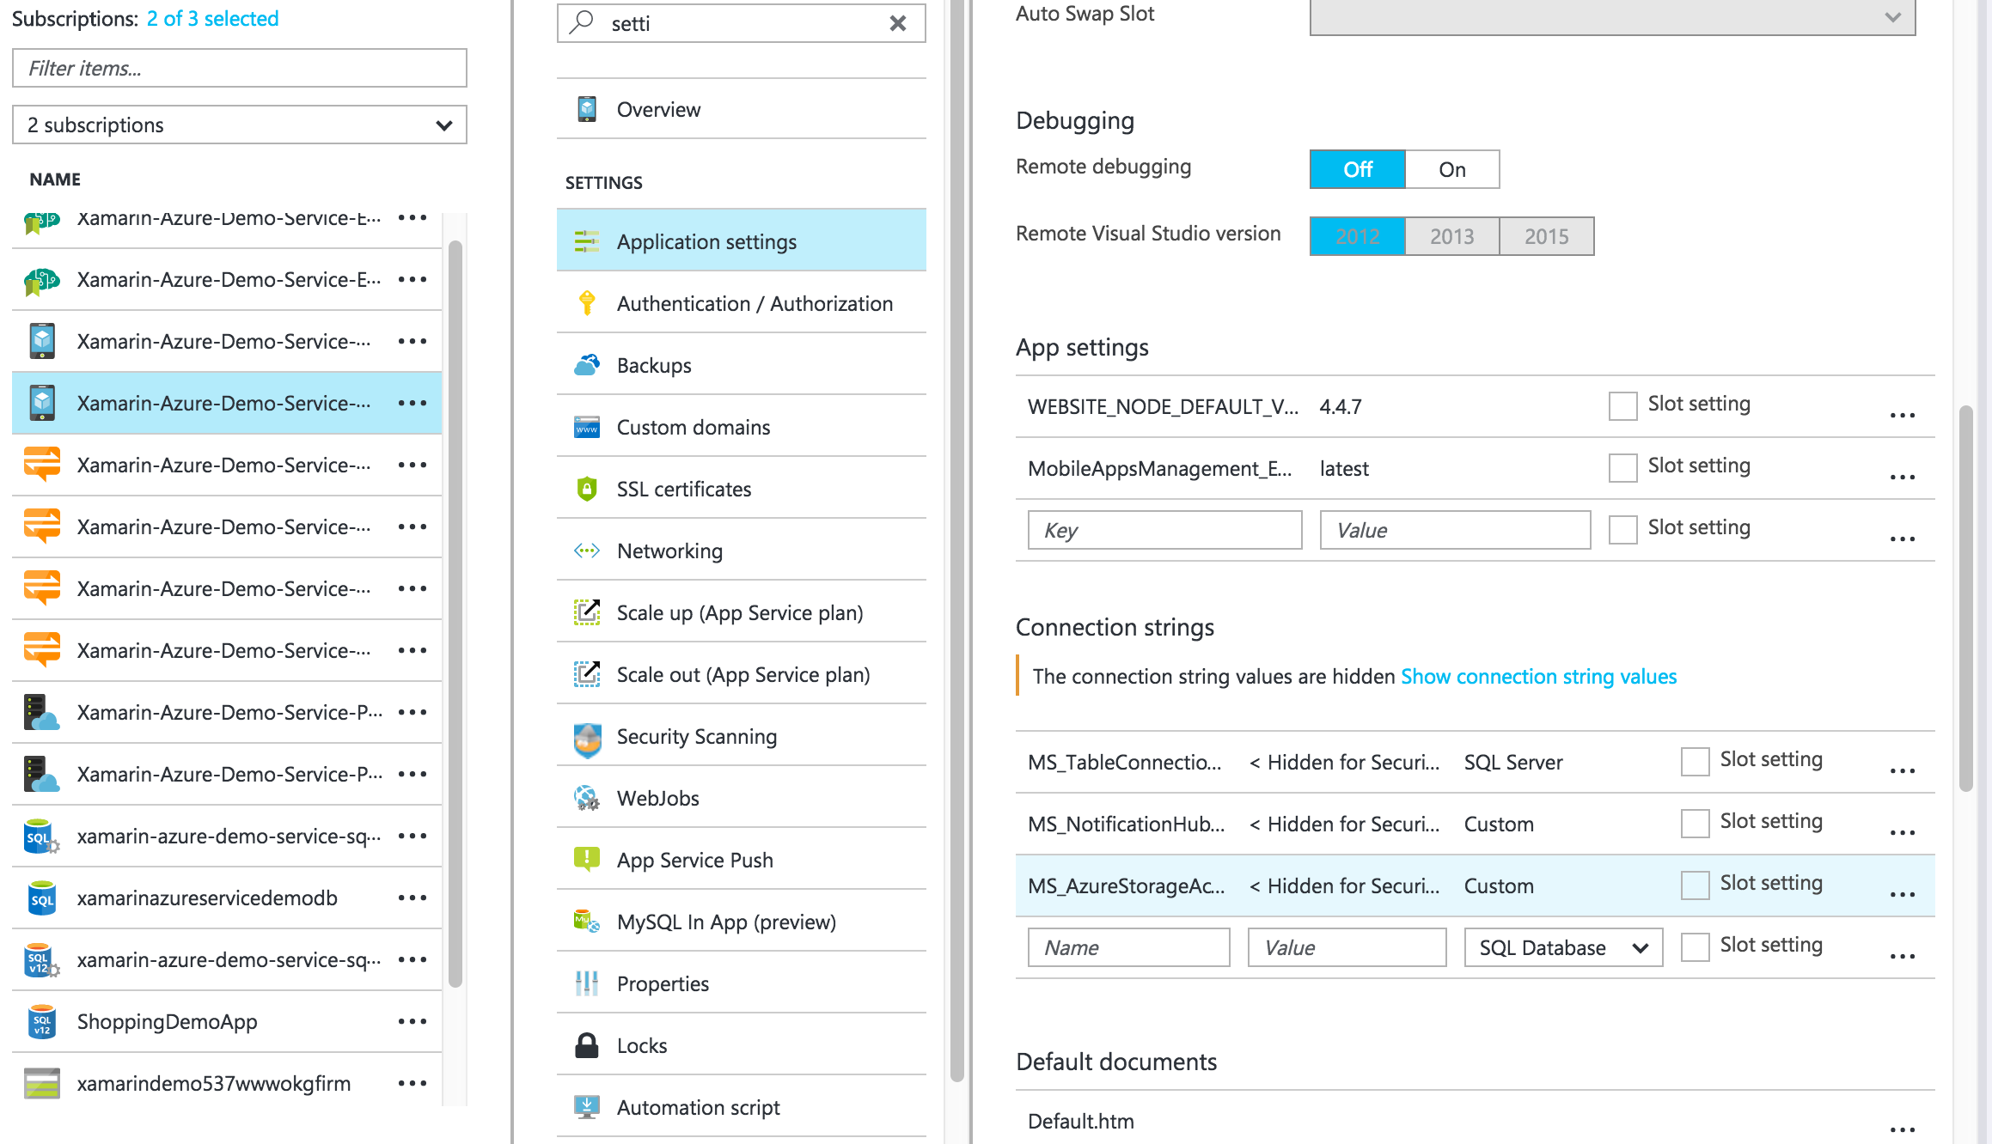
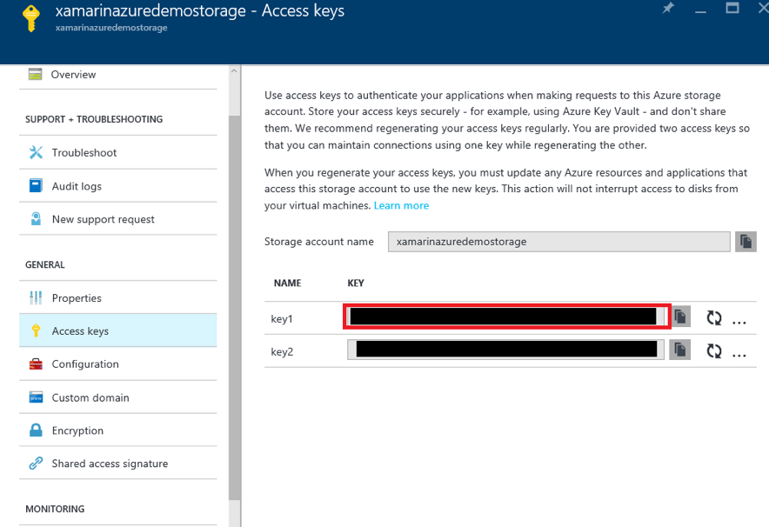
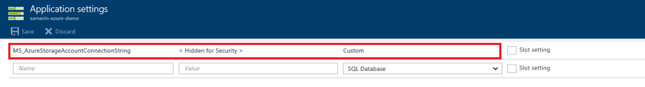
Store your app data in the cloud with Azure Storage
Create a storage account
In the Azure Portal, navigate to your newly created storage account and click the Keys icon. Copy the Primary Connection String.
Navigate to your mobile app backend. Under All Settings -> Application Settings -> Connection Strings, create a new key named MS_AzureStorageAccountConnectionString and use the value copied from your storage account. Use Custom as the key type.

Slide 43
Store your app data in the cloud with Azure Storage
[MobileAppController]
public class SaleItemStorageController : StorageController<SaleItem>
{
// POST tables/SaleItem/F366EBB2-6D7D-4E09-A4F2-DF16819F6302/StorageToken
[Route("tables/SaleItem/{id}/StorageToken")]
public async Task<HttpResponseMessage> PostStorageTokenRequest(string id, StorageTokenRequest value)
{ StorageToken token = await GetStorageTokenAsync(id, value);
return Request.CreateResponse(token);
}
// Get the files associated with this record
// GET tables/SaleItem/F366EBB2-6D7D-4E09-A4F2-DF16819F6302/MobileServiceFiles
[Route("tables/SaleItem/{id}/MobileServiceFiles")]
public async Task<HttpResponseMessage> GetFiles(string id)
{
IEnumerable<MobileServiceFile> files = await GetRecordFilesAsync(id);
return Request.CreateResponse(files);
}
// DELETE tables/SaleItem/F366EBB2-6D7D-4E09-A4F2-DF16819F6302/MobileServiceFiles/{name}
[Route("tables/SaleItem/{id}/MobileServiceFiles/{name}")]
public Task Delete(string id, string name)
{
return base.DeleteFileAsync(id, name);
}
}
Add a storage controller to the server
Allow your backend to respond to client requests by adding a storage controller to your server.
The code related to the storage controller in Shopping Demo App can be found in SaleItemStorageController class:

Slide 44

Push Notifications
Send and Receive Push Notifications on iOS, Android, and Windows
Azure Notification Hubs provide an easy-to-use infrastructure that enables you to send mobile push notifications from any backend (in the cloud or on-premises) to all major platforms, including—iOS, Android, and Windows.
With Notification Hubs you can easily send cross-platform, personalized push notifications, abstracting the details of the different platform notification systems (PNSs). With a single API call, you can target individual users or entire audience segments containing millions of users, across all their devices at the same time.
Push notifications drive better engagement with your app users. Send breaking news, enterprise-wide announcements, and location-based coupons.

Slide 45
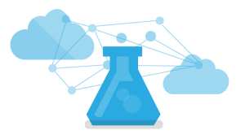
Cognitive Services

Slide 46
Cognitive Services
Use Microsoft Cognitive Services to personalize your app’s responses
Microsoft Cognitive Services (formerly Project Oxford) are a set of APIs, SDKs and services available to developers to make their applications more intelligent, engaging and discoverable.
Microsoft Cognitive Services expands on Microsoft’s evolving portfolio of machine learning APIs and enables developers to easily add intelligent features – such as emotion and video detection; facial, speech and vision recognition; and speech and language understanding – into their applications.
Our vision is for more personal computing experiences and enhanced productivity aided by systems that increasingly can see, hear, speak, understand and even begin to reason.

Slide 47
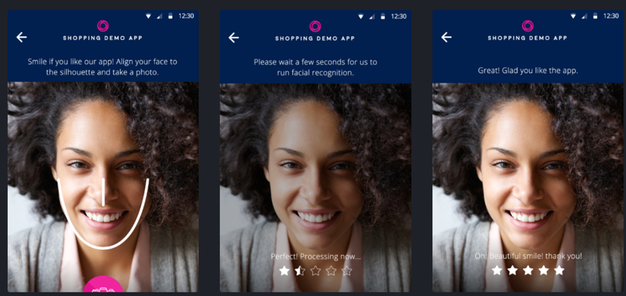
Cognitive Services
Use Microsoft Cognitive Services to personalize your app’s responses
Microsoft Cognitive Services let you build apps with powerful algorithms using just a few lines of code. They work across devices and platforms such as iOS, Android, and Windows, keep improving, and are easy to set up.
The Shopping Demo app uses the Emotion API to analyze faces and detect a range of feelings to help rate the app. The app uses the camera to get a photo of the users’s face and calculates a rating for the app based on happiness. The more you smile, the better you rate the app.

Slide 48
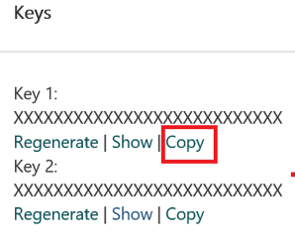
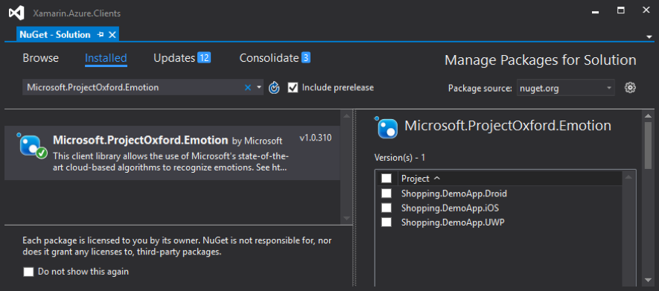
Cognitive Services
Use Microsoft Cognitive Services to personalize your app’s responses
Subscribe to Cognitive Services https://www.microsoft.com/cognitive-services/en-us/sign-up and get the API key
Place that key on the file AppSettings.cs
Demo App has already the NuGet package for Microsoft.ProjectOxford.Emotion, and is ready to use it:

Slide 49
Cognitive Services
Use Microsoft Cognitive Services to personalize your app’s responses
RatingProcessingViewController.cs:
UserDialogs.Instance.ShowLoading("Processing...");
UIImage sendImage = UIImage.FromImage(CaptureImageView.Image.CGImage, 1.0f, UIImageOrientation.Right);
Emotion[] detectedEmotions = await emotionClient.RecognizeAsync(sendImage.AsJPEG().AsStream());
Emotion emotion = detectedEmotions.FirstOrDefault();
UserDialogs.Instance.HideLoading();
if (emotion != null)
{
SetRating(emotion.Scores.Happiness);
}

Slide 50
Cognitive Services
Use Microsoft Cognitive Services to personalize your app’s responses
SmileActivity.cs:
using (var memoryStream = new MemoryStream(photoBytes))
{
var emotionService = new EmotionService();
var firstFaceEmotion = default(Emotion);
try
{
var emotionList = await emotionService.RecognizeAsync(memoryStream);
firstFaceEmotion = emotionList.FirstOrDefault();
}
catch
{
await UserDialogs.Instance.AlertAsync("There was an error analyzing your photo. Please, try again.");
}
[...]
}

Slide 51
Cognitive Services
Use Microsoft Cognitive Services to personalize your app’s responses
Rating.xaml.cs:
var photoStream = await this.mediaCaptureHelper.TakePhotoAsync();
photoStream = await this.mediaCaptureHelper.RotatePhoto(photoStream);
await this.SetCapturedImage(photoStream);
var emotionService = new EmotionService();
var detectedEmotions = await emotionService.RecognizeAsync(photoStream.AsStream());
Emotion emotion = detectedEmotions.FirstOrDefault();

Slide 52
Push Notifications

Slide 53
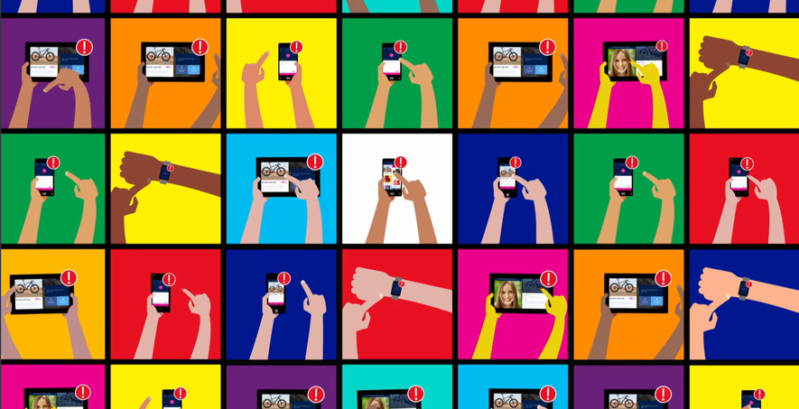
Push Notifications
Send and Receive Push Notifications on iOS, Android, and Windows
This tutorial shows you how to use Azure Notification Hubs to send and receive push notifications in the Shopping Demo App. The app sends and receives notifications when items are sold.

Slide 54
Push Notifications
Setting up Push Notifications in server side : Setting up the Notification Hub
Generate the Certificate Signing Request file
Register your app for push notifications
Create a provisioning profile for the app

Slide 55
Push Notifications
Setting up Push Notifications in server side : Setting up the Notification Hub
Enable Google Cloud Messaging

Slide 56
Push Notifications
Setting up Push Notifications in server side : Setting up the Notification Hub
Register your app for the Windows Store

Slide 57
Thank You! Questions?
Ben Ishiyama-Levy
Xamarin Evangelist
ben@xamariners.com

